Slide 1
Computer Dissection

Slide 2
Computer Parts
• Input/output
• Central Processing Unit (CPU)
• Memory

Slide 3
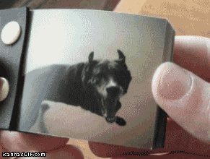

Slide 4
Animation
multiple frames moving fast enough that our eyes perceive that an object in an image is in motion
So how do you create an animation? You start by making models, which are things that represent the world. They’re built using vertices, edges, and faces (Draw what vertices, edges, and faces look like).
Anyone Remember Binary?
Inside a computer all of these are data; computers represent data as binary

Slide 5
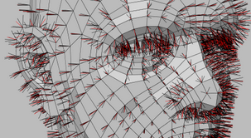

Slide 6
Bus
A system bus connects all of the main components. A bus is a collection of hardware and software through which data is transmitted from one part of a computer to another.
Can someone draw me a bunch of cars and a bunch of streets?

Slide 7
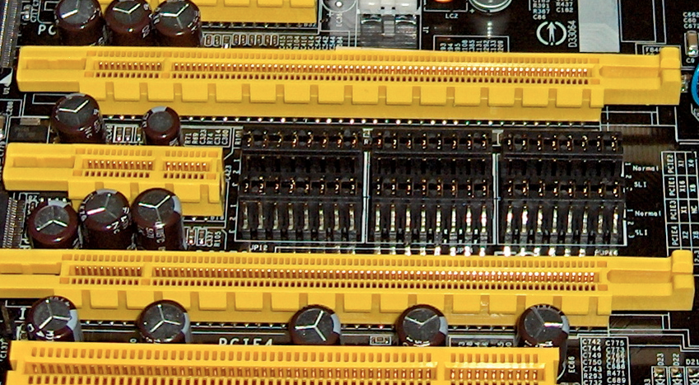
4 PCI Express bus card slots

Slide 8
Abstraction
Using examples to symbolize processes or rules - A bus is like a highway on which data travels within a computer.
Metaphor – a phrase to make a comparison between two thing
- You can think of transmission as a postman driving a car delivering mail (data)
-Or blood cells and your circulatory system
-The lawn is a green carpet

Slide 9
Question
Can anyone tell me a short story or a metaphor on how data is transported from one part to the other?
How does a controller work in a game console?

Slide 10
Input & output: How do we use the BUS?
Input and output is all of the communication system that happens into and out of the computer.
Input is the signals or data received by the computer and output is the signals or data sent from the computer.
Can anyone tell me what are some daily things we use that pertains to input and output?

Slide 11
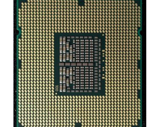

Slide 12
Central Processing Unit
The Central Processing Unit is like the “brain” of the computer – it’s where the stuff happens. It carries out the instructions for the computer to function by performing the basic arithmetic, logical, and input/output operations. There are three main parts to the CPU:
Control Unit,
Arithmetic Logic Unit (ALU)
Memory registers

Slide 13
CPU Parts
Arithmetic Logic Unit - addition, multiplication, binary manipulation, logic evaluation
Memory Registers - holds data that needs to be processed right away for calculations usually in ALU
Control unit - it reads and interprets instruction and determines the order of execution of instructions
--just like your scratch program
--controls communication and coordination between input and output devices, and control flow of
--data between all devices

Slide 14
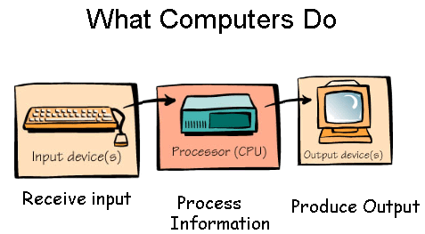

Slide 15
Video Games and Animation
How does Input and Output, CPU, and BUS relate to Video Games and Animation

Slide 16
Language Abstraction
Go down to compile and go up to disassemble
So, python and is a scripting language
C++ is a high level language
Mips is an assembly language
Machine Code (Hexadecimal)
Binary Code (1s and 0s)
The closer you are to the bottom means the closer you are to the hardware

Slide 17
Memory, more abstraction
CPU (Volatile) – Processing each node of our animation
CPU CACHE (Volatile) - Next to be processed node,vertex,edges of our animation
PHYSICAL MEMORY (Volatile) RAM – Where we store our programs or animation when the computer is on and ready to be processed
SOLID STATE MEMORY (Non-Volatile) – Where we store our animation offline faster
Virtual Memory (File Based Memory) – Where we store our animation offline

Slide 18
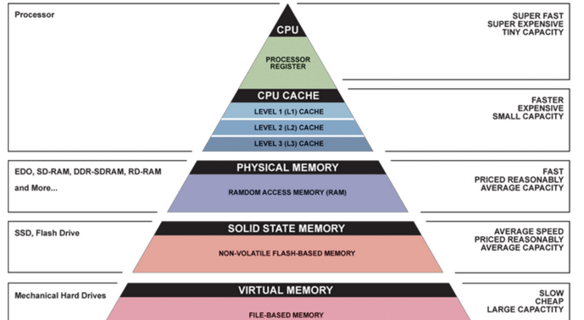

Slide 19
Static Electricity
Static electricity occurs when there is an imbalance of positively and negatively charged atoms. Electrons then jump from atom to atom, releasing energy. Two examples of static electricity are lightning and rubbing your feet on the carpet and then touching a doorknob.

Slide 20
Direct Current
Current electricity is a constant flow of electrons. There are two kinds of current electricity: direct current (DC) and alternating current (AC). With direct current electricity the electrons move in one direction. Batteries produce direct current. In alternating current, electrons flow in both directions. Power plants produce AC electric current. Alternating current (AC) is the type of electricity that JCPB distributes to you for use.

Slide 21
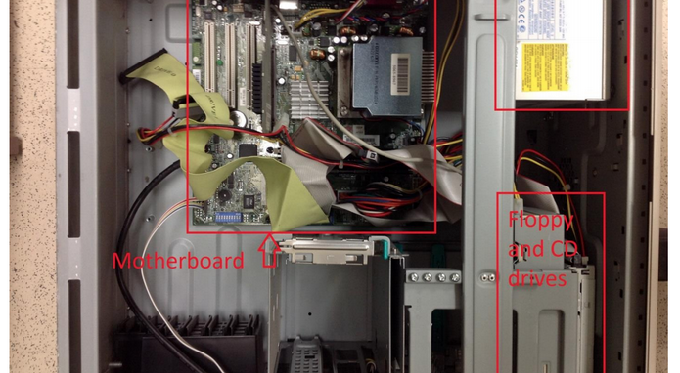

Slide 22
Parts of the computer
Hard Disk / Solid State Drives
HD
So non volatile, doesnt need electricity to store data
Like putting stuff in your notebook compared to putting stuff in your memory
Contains small spinning platters that contain data and has moving parts to write data
Like a vinyl player
SSD
No moving parts, just like a flash drive - uses flash memory - uses grid of electric cells

Slide 23
floppy disk and cd drives - like cd that store information and send
Real time clock/battery – has a small battery for offline clock
integrated circuits - are small circuits that help the motherboard

Slide 24
fans and heat sink - things to keep your computer cool and not to overheat - so
a heat sink maximizes the area in contact with a cooliing system - some use mineral oil
why does submerging your computer to mineral oil work as a cooling system?

Slide 25
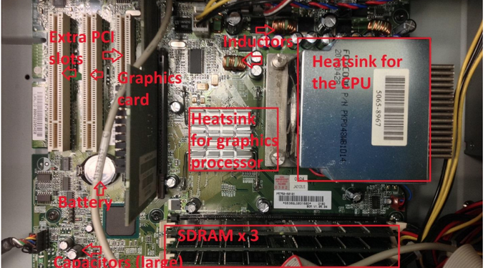

Slide 26
capacitors - in the motherboard that regulates voltage, store electrical charge so that your computer has a smooth flow of current
inductor- in the motherboard. so inductors that have copper wire that wraps them to create a magnetic field
. so it can store energy in its magnetic field. it tends to resist change in any current flowing through it
. so to step down power from an outlet to the low voltage required by computers.
can anyone guess what happens if we just allowed too much voltage to pass?

Slide 27
Switches:The switches allow you to override some settings, such as the clock speed!xv
Thick wiring/buses are bunches of wires that carry data between different components/parts. The most
visible ones here connected the hard drive (removed) to the motherboard, and the floppy disk/CD input
to the motherboard.

Slide 28
PCI Expansion Slots:
Sometimes it’s nice to be able to add extra stuff to your computer, such as a dedicated sound card, a
network modem, or more USB ports. Usually, these will plug into the motherboard’s extra PCI (Peripheral
Component Interconnect) slots

Slide 29
Random Access Memory (RAM): - volatile
Whenever you load up a program on your computer, it is read from your drive into RAM. That’s why
having more RAM in your computer lets you run more programs at once before your computer starts to
slow down. RAM is kind of like a hard drive, except that it’s much faster (and more expensive) because it
doesn’t have any moving parts. It is also cleared every time you turn the computer off.

Slide 30
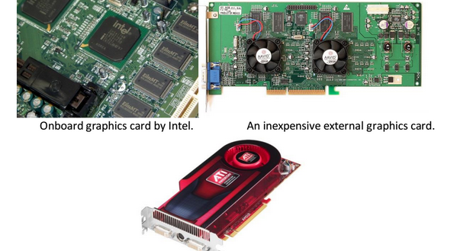

Slide 31
Ports: Connections for peripherals
Graphics Processing Unit (GPU)/Graphics Card:
The graphics card is what’s responsible for drawing things on your screen, especially in 3D. New graphics
Graphics cards are great for doing many small calculations very quickly, which helps with
3D rendering but also has other applications such as bitcoin mining or password cracking.

Slide 32
Reference
http://en.wikipedia.org/wiki/Bus_%28computing%29#mediaviewer/File:PCIExpress.jpg
https://www.google.ca/search?q=3ds+vertices+nodes&espv=2&biw=1213&bih=716&tbm=isch&source=lnms&sa=X&ei=_QD7VNq3A4GWyASzhILwDg&ved=0CAcQ_AUoAQ&dpr=1#imgdii=_&imgrc=FYc73pVVugQACM%253A%3Bg7WZTeo5ZhuX2M%3Bhttp%253A%252F%252Fi153.photobucket.com%252Falbums%252Fs202%252Fanimatics%252Fsketchhead2-D.png%3Bhttp%253A%252F%252Fforums.newtek.com%252Farchive%252Findex.php%252Ft-126054.html%3B496%3B726
http://giphy.com/gifs/funny-dog-CxC4gyKv1ChSE
DiscoverE computer dissection slides

